Slide 1
Deep Dive Python Scripting in ArcGIS Pro
By Evan Myers
Palm Beach County Water Utilities Department

Slide 2
What to Expect?
Setting up a python environment that will be used by multiple users
At the same time, it can be used outside of ArcGIS Pro
How is python used at Palm Beach County Water Utilities? How has it helped standardize workflows for adding utility data?
There were some issues with the quality of our data we didn’t know we had, especially with connectivity and spatial relationships.
AI is everywhere, especially in with coding.
How can we use it for coding? Its not as straight forward as it seems…
Examples of scripts that PBC WUD uses and ones that anybody could use.

Slide 3
Topics
Python Environment for ArcGIS Pro
Good Scripting Practices for Tools
Script Tool Parameters and Validator
Advantages and Disadvantages of using AI for coding
Useful lines of code
Frustrating Python Errors and how to Resolve them
Example scripts and use cases

Slide 4
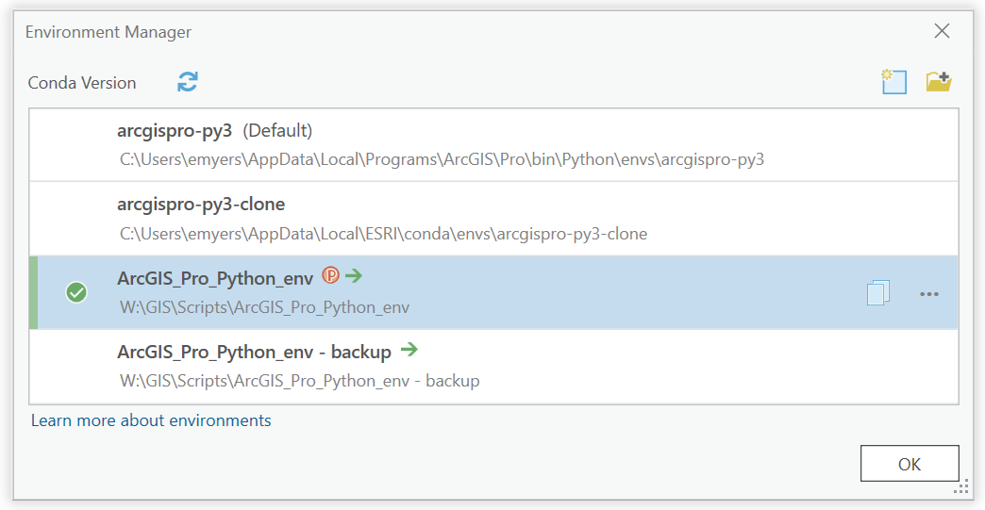
Python Environment for ArcGIS Pro
It’s a good idea to make the clone and a backup on a network drive.
Any package you install will be seen by anyone using the environment. No need to go each machine and install individually.

Slide 5
Python Environment for ArcGIS Pro
Having a python environment in a common location where multiple users can use it has many advantages:
Everyone will have the same Python version and packages.
Easy to update and maintain. Just select the environment and click update.
Easier to troubleshoot issues with script tools or code. No need to worry if a package is missing or the wrong version; everyone is using the same environment.
Very simple to set up compared to other methods shown later.

Slide 6
Set up a Python IDE, don’t settle with the Python Window
An IDE, Integrated Development Environment, is a handy way to write code outside of the python interpreter in ArcGIS Pro.
Easy to organize and visualize code.
Incorporates “IntelliSense” (gives hints as you write)
Can set up multiple Interpreters if bouncing between multiple scripts. Seamlessly go between different versions of python if needed.

Slide 7
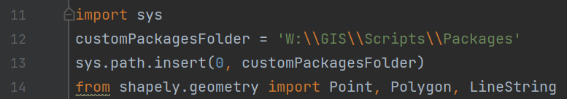
Good Scripting Practices
If using a custom package that is only needed for one script, you can add these lines of code:
This adds an additional file path to the python system’s environment. Temporarily allowing the script to look in another folder for imports.
The folder of packages can be difficult to maintain
(if you didn’t make them :P)
Notes:
2nd picture – INSERT puts the folder first in the list of paths. APPEND puts it at the end.

Slide 8
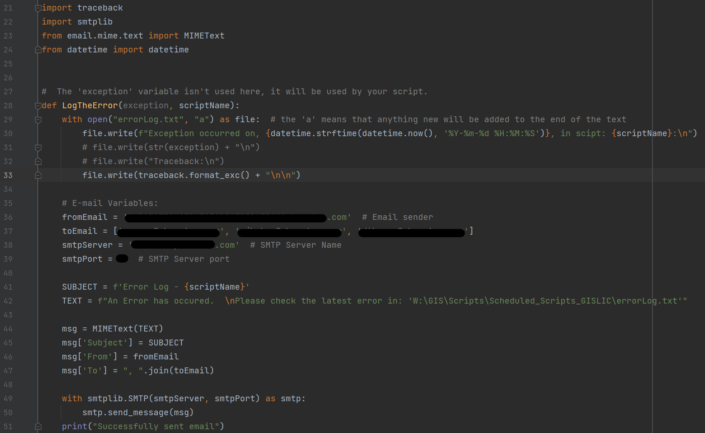
Logging Errors

Slide 9
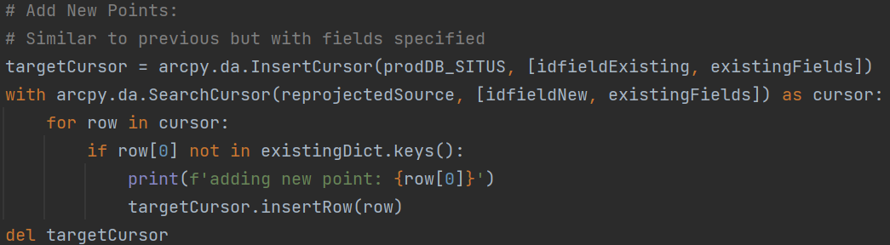
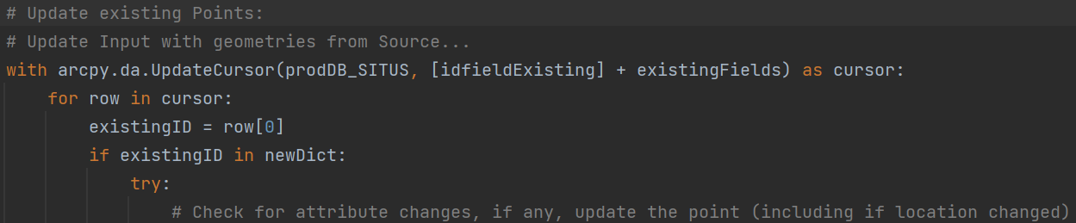
Good Scripting Practices
If downloading outside sources to update a local database, put a line of code to check if the source isn’t empty:
Using arcpy.da.UpdateCursor can be faster than field calculator.
Use a combination of the UpdateCursor and InsertCursor to replace joins:

Slide 10
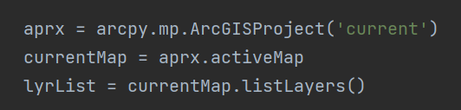
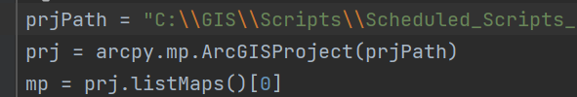
Preparing a script to work with feature layers
Interacting with layers in your map:
Interacting with a map from the outside:

Slide 11
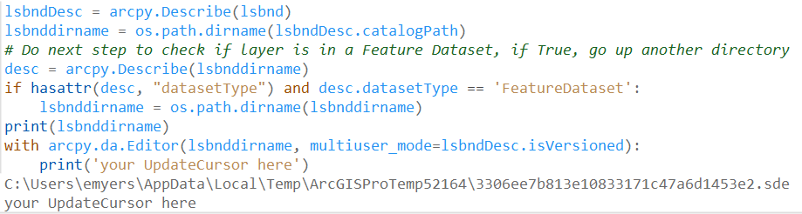
Preparing scripts to work with map layers
How do you find the Geodatabase for a layer in a map? This method is best suited for starting an Edit session because it searches for the actual workspace location.
How would you find the root directory?

Slide 12
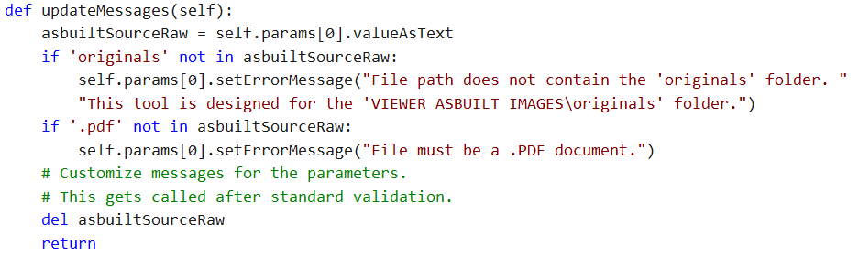
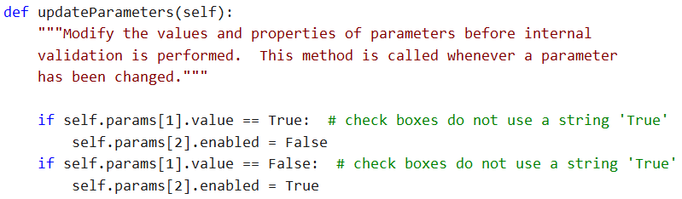
Preparing an ArcGIS Pro Script tool’s Validation
A Script Tool Validator can enhance the functionality of your tools:
Automatically fill out menus with current map layers, databases, etc.
Change Parameters based on selections or inputs
Notes:
Open the “Custom Export” tool as the example.
Without setting a default for check boxes in Parameters, they act like a ‘Nothing’ box until its checked on or off, then it’s a True or False.

Slide 13
Advantages of Using AI
Using AI for code has been rising in popularity for a few years and has helped many people get started writing code with no experience.
Troubleshoot issues.
Answer questions about functions that are not easy to understand.
Find more functionality for modules.
Clean up your code; make it simpler.
Can be used to write entire scripts.

Slide 14
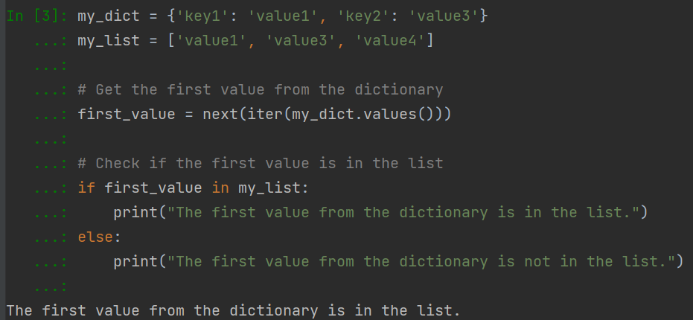
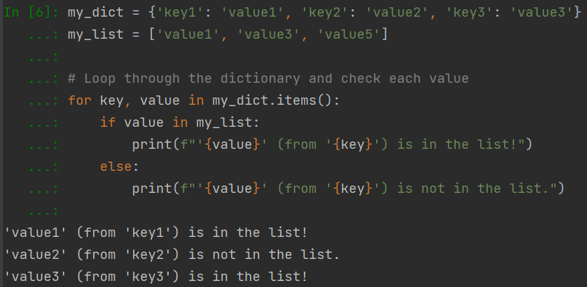
Disadvantages of Using AI
Sometimes when asking an AI for help, it might give you code that isn’t want you wanted or it simply doesn’t work. Sometimes you need to be extremely literal with your question:
Notes:
1st picture: wasn’t clear enough, have to ask differently
2nd: good answer

Slide 15
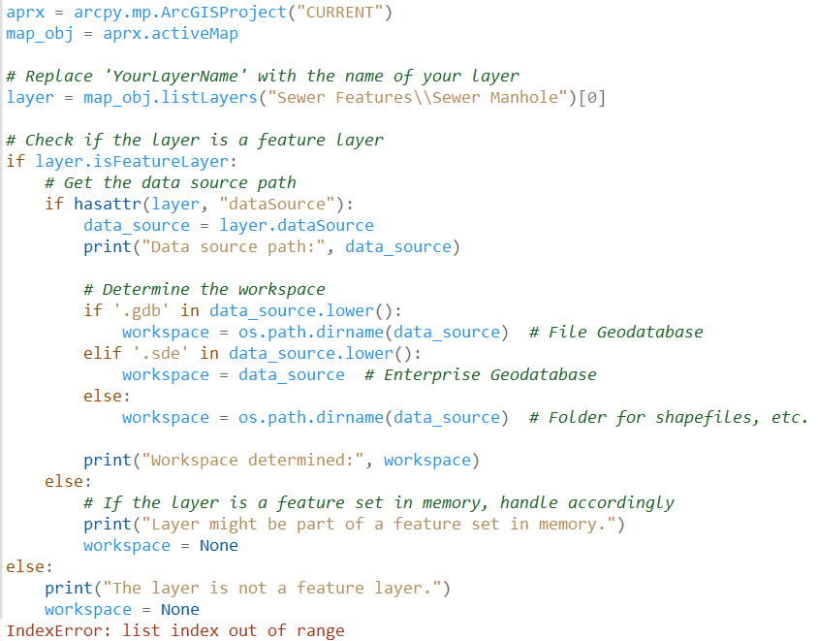
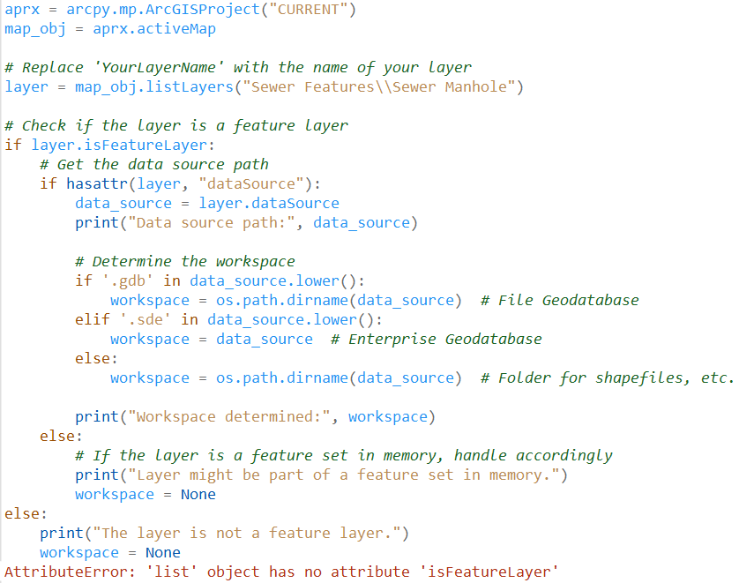
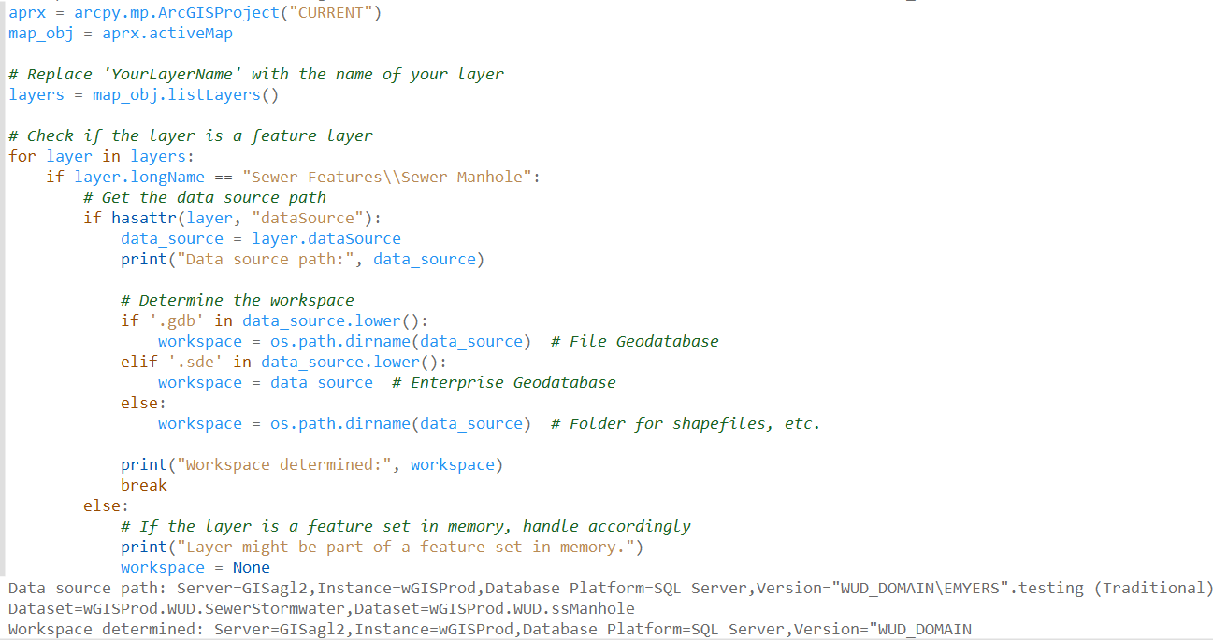
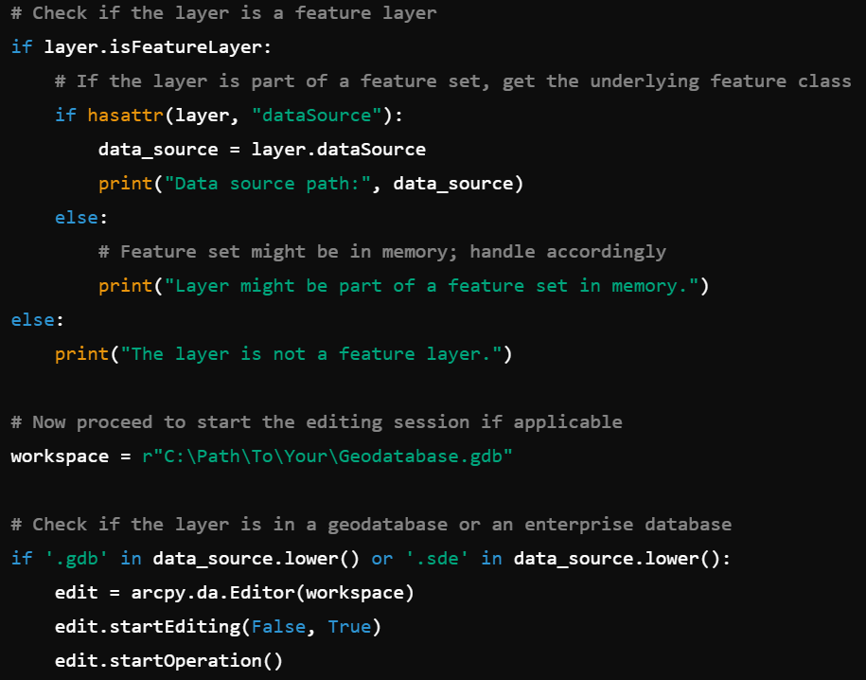
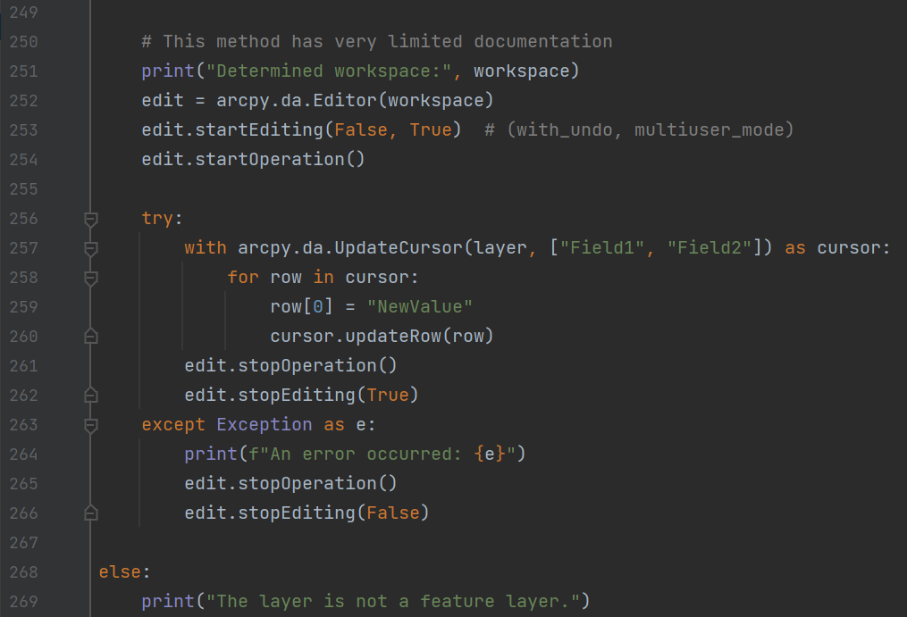
Disadvantages of Using AI
Answers can be completely wrong or needlessly complicated:
Notes:
1st and 2nd picture: layer variable isn’t going to work for grouped features , and it will only work for a .GDB feature not one in an .SDE
3nd picture: fixed the code so the grouped layer works, but it still isn’t going to work because “data_source” variable is points to the layer, not a database “C:\test\database.gdb\sewerdata\manholes”
4th picture: does the “layer.datasource” thing again, completely pointless, ends up not using it.
5th picture: Lets say that we did use the “data_Source variable”, oops its not a database connection path.

Slide 16
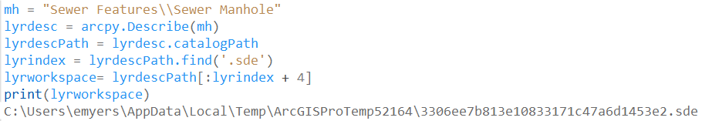
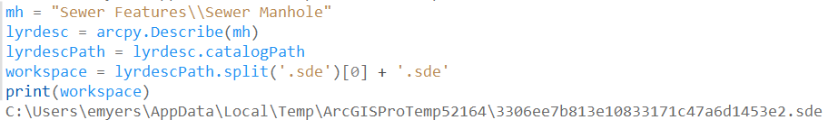
AI provides different, sometimes strange, answers for what seems simple
AI’s answer for finding a layer’s Database:
One that’s more straightforward:
Notes:
Top: Looks for ‘.sde’, counts its position + 4, gets file path for sde
Bottom: split the path at .sde, creating a list, take the first item then add ‘.sde’

Slide 17
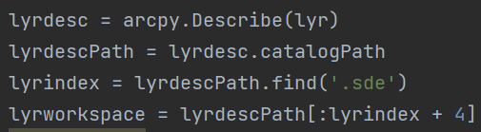
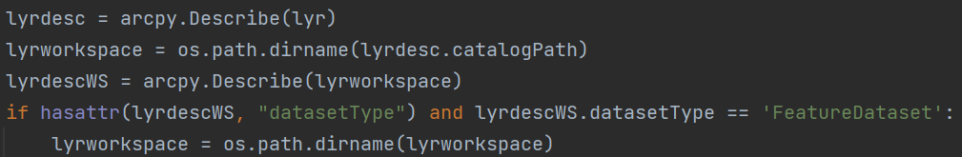
An AI’s Answer might not be the best when working with Geodatabases
AI’s answer for finding a layer’s Database file path:
One method to find the correct database every time:
Notes:
AI’s method does a counting method on the path. Very different, unconventional method to find it. Doesn’t account for ‘non-sde’ type databases.

Slide 18
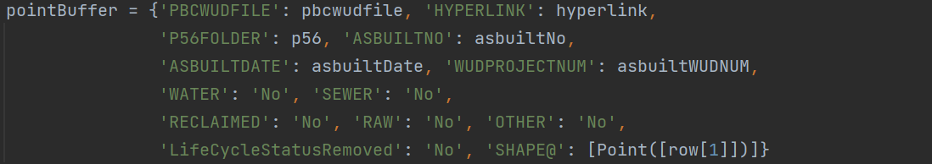
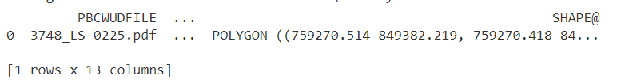
Useful Lines of Code
Some of the most used modules / packages that I use in nearly every tool:
os, sys
errorLogger
Shapely
Spatial analysis for points, lines, and polygons
Intersections, contains, within, nearby features
STRtree – “Sort-Tile-Recursive” R-Tree. Store point geometries in a spatial index for quick spatial analysis.
Geopandas
Create and modify an in-memory table that can be used to update a feature’s attribute table. This was used to create a new polygon with all its attributes prefilled without having to run an UpdateCursor.

Slide 19
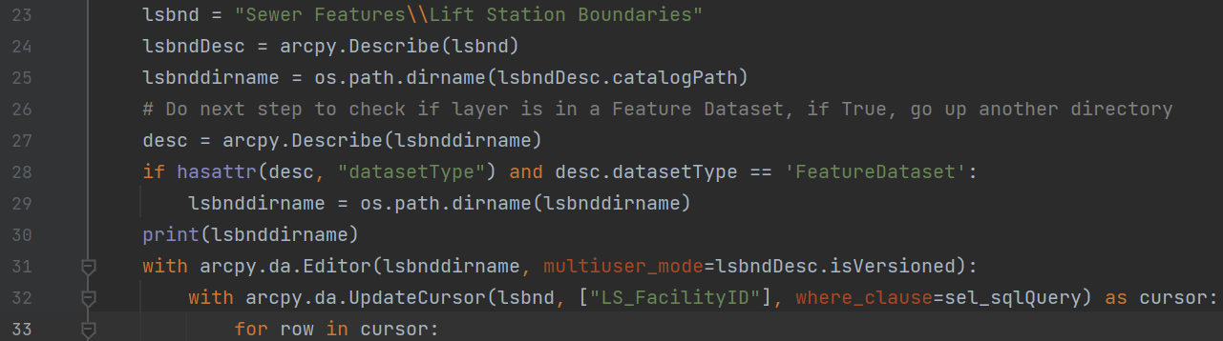
Easier way to Start an Edit Session for Versioned Database
Directly provide the layer
Create a “Describe” object. This can be used for any type of feature class, local or enterprise.
Using Describe can get the database path and check if its versioned.
The Editor is inside a “with” statement to easily handle all the edit operations.

Slide 20

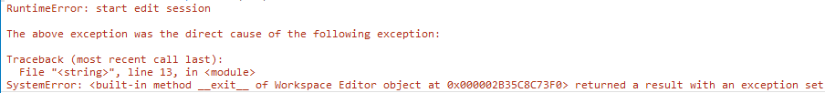
Python Errors and Resolving Them
Starting an edit session can sometimes be very frustrating:
Using the traditional way to start an edit session (e.g “edit.startEditing”) can be hard to diagnose issues. For me, it was harder to understand.
Solution: The workspace that is set in the script is not a Geodatabase. It is most likely set as a Feature Dataset instead.
Solution: Save pending edits before running the script

Slide 21

Python Errors and Resolving Them
If parts of your script are not addressed, unexpected behavior with Pro can start happening:
Table of Contents or the Ribbon might turn on and off.
Performance might degrade.
A tool might work one time and stop working later on.
Error messages might stop being helpful.
Be sure to close cursors, exit scripts, or ‘del stuff’
Some code will persist even after the tool is finished running.
E.g. sys.tracebacklimit

Slide 22
Python Errors and Resolving Them
If interacting with layers or attributes, the new feature or attributes will not show right away. Something needs to be done to the layer visually so it can update.
Refresh the table, database connection, or Pro
Add a line of code that refreshes the symbology of a layer in the map. The layer just needs to be in the same map:

Slide 23
Example scripts

Slide 24

Thank You!
Questions? Suggestions?
Scan to view or download the
code examples and other scripts
Evan Myers
emyers@pbcwater.com

